Slide 1

Employee Data Analysis using Excel
STUDENT NAME: ANUSHKA RANADE
REGISTER NO: 312209164 NAAN MUDALVAN ID:asunm1353312209164
DEPARTMENT : B.Com (Commerce)
COLLEGE: ANNA ADARSH COLLEGE FOR WOMEN

Slide 2

PROJECT TITLE
Employee Performance Analysis using Excel

Slide 3
AGENDA
Problem Statement
Project Overview
End Users
Our Solution and Proposition
Dataset Description
Modelling Approach
Results and Discussion
Conclusion

Slide 4
PROBLEM STATEMENT
Analyzing employee data sets is crucial for several reasons
Improving Employee Experience
Enhancing Productivity
Informed Decision-Making
Identifying Trends and Patterns
Ensuring Fairness and Compliance
Strategic Planning

Slide 5
WHO ARE THE END USERS?
SOLUTION FOR EMPLOYEE PERFORMANCE ANALYSIS
Data collection and integration
Performance metrics
Advanced analytics
Personalised insights
Continuous feedback and improvement
VALUE PROPOSITION
Enhanced productivity
Employee engagement and retention
Data-driven decisions
Improved organizational performance
Scalability and flexibility

Slide 6

PROJECT OVERVIEW
THE PRIMARY OBJECTIVE OF THIS PROJECT IS TO:
01
systematically analyze employee performance across the organization
02
identify key factors affecting performance
03
develop strategies to improve overall productivity
04
engagement, and job satisfaction.
05

Slide 7
Reason for employee performance analysis
Employee performance analysis is crucial for several reasons:
Feedback and improvement
Goal setting
Career development
Increased productivity
Alignment with organisational goals
Employee retention

Slide 8
OUR SOLUTION AND ITS VALUE PROPOSITION
SOLUTION FOR EMPLOYEE PERFORMANCE ANALYSIS
Data collection and integration
Performance metrics
Advanced analytics
Personalised insights
Continuous feedback and improvement
VALUE PROPOSITION
Enhanced productivity
Employee engagement and retention
Data-driven decisions
Improved organizational performance
Scalability and flexibility

Slide 9
Dataset Description
Employee ID: Unique identifier for each employee in the organization. Described in numbers
1
First name: First name of the employee in text
2
Last name: Last name of the employee in text
3
Business unit: The specific business unit or department to which the employee belongs, in text.
4
Employee status: The current employment status of the employee i.e. active, on leave, terminated.
5
Employee type: The type of employment the employee has full-time, part-time, contract.
6
Gender code: A code representing the gender of the employee, M for male, F for female, N for non-binary.
7
Performance score: A score indicating the employee’s performance level i.e. excellent, satisfactory, needs improvement.
8
Current employee rating: The current rating or evaluation of the employee’s overall performance.
9

Slide 10

THE "WOW" IN OUR SOLUTION
Formula used for finding the performance levelof employees
=IFS(Z8>=5,"VERY HIGH",Z8>=4,"HIGH",Z8>=3,"MED",Z8>=2,"LOW",Z8>=1,"VERY LOW")
3/21/2024 Annual Review
10

Slide 11
MODELLING
DATA COLLECTION
Downloaded the data set from Edunet dashboard
Opened the data in excel
Saved the file in the desktop as an (.xls) file
FEATURE COLLECTION
Used conditional formatting
Used fill color option
used filter option to separate blanks in the column
DATA CLEANING
filtering the data according tour needs
making the data into a structured data
and separating the important columns
11

Slide 12
Pivot TABLE
Taking out the business unit, gender code, first name, and performance level
Removing all the blank value by using filter option.
And your pivot-table is ready.
GRAPH
Used for the visual representation of the table to give us a clear view of the employe
Can depict increase or decrease in the performance level

Slide 13
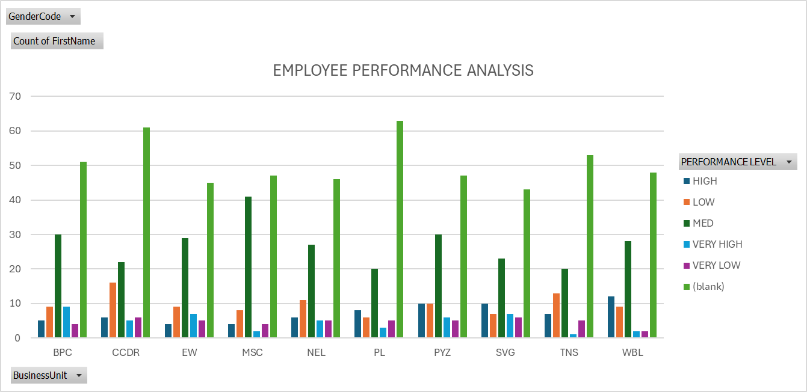
RESULTS
13

Slide 14
RESULTS

Slide 15
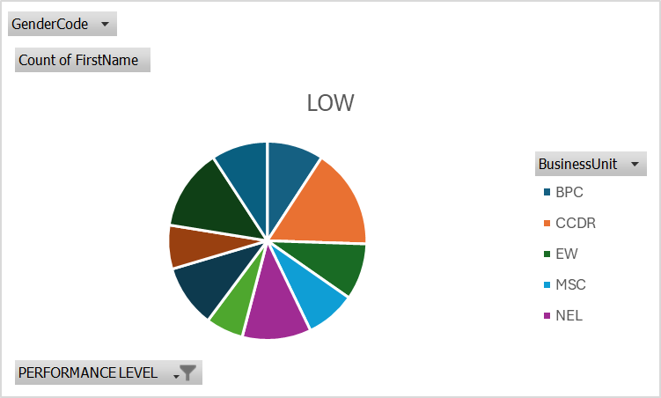
RESULTS

Slide 16
CONCLUSION
The highest performance level is WBL
THE LOWEST PERFORMANCE LEVEL IS PL

